Slide 1
Design and Analysis of Algorithms BFS, DFS, and topological sort
From: Haidong Xue
Slides Provided By: Muhammad Atif Tahir
Presented by: Waheed Ahmed

Slide 2
Graph Traversal
Two techniques of graph traversing for both directed or undirected graphs:
Breadth First Search (BFS) – Uses Queue
Depth First Search (DFS) – Uses Stack

Slide 3
What are BFS and DFS?
Two ambiguous terms: search, traversal
Visit each of vertices once
E.g.: tree walks of a binary search tree
Traversal
Search
Start from a vertex, visit all the reachable vertices
Search

Slide 4
What are BFS and DFS?
To eliminate the ambiguity, in my class
Search indicates
Start from a vertex, visit all the reachable vertices
Traversal indicates
Visit each of vertices once
However, in other materials, you may see some time “search” is considered as “traversal”

Slide 5
What are BFS and DFS?
BFS
Start from a vertex, visit all the reachable vertices in a breadth first manner
DFS
Start from a vertex, visit all the reachable vertices in a depth first manner
BFS or DFS based traversal
Repeat BFS or DFS for unreachable vertices

Slide 6
BFS, BF tree and shortest path
Breadth-first search
From a source vertex s
Breadth-firstly explores the edges to discover every vertex that is reachable from s
BFS(s)
visit(s);
queue.insert(s);
while( queue is not empty ){
u = queue.extractHead();
for each edge <u, d>{
if(d has not been visited)
visit(d);
queue.insert(d);
}
}

Slide 7
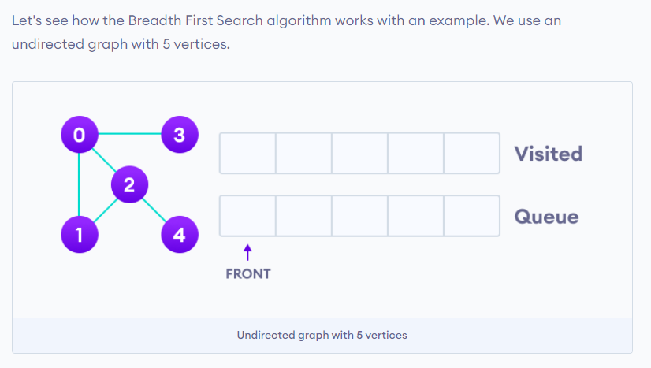
Graph Traversal : BFS

Slide 8
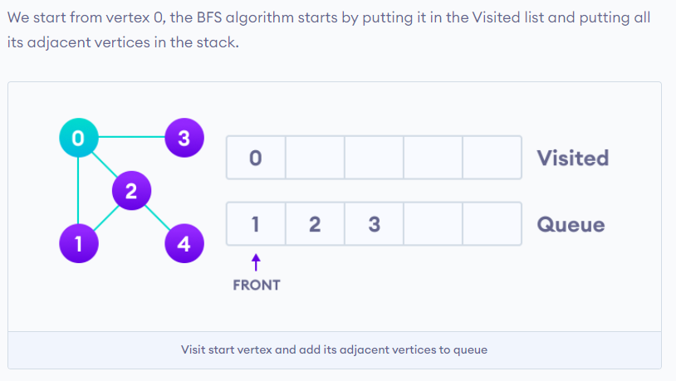
Graph Traversal : BFS

Slide 9
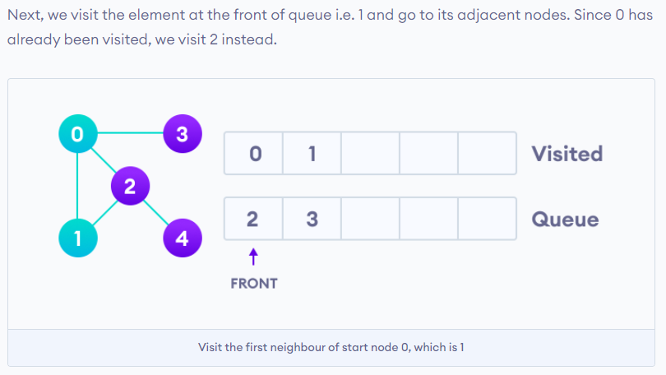
Graph Traversal : BFS

Slide 10
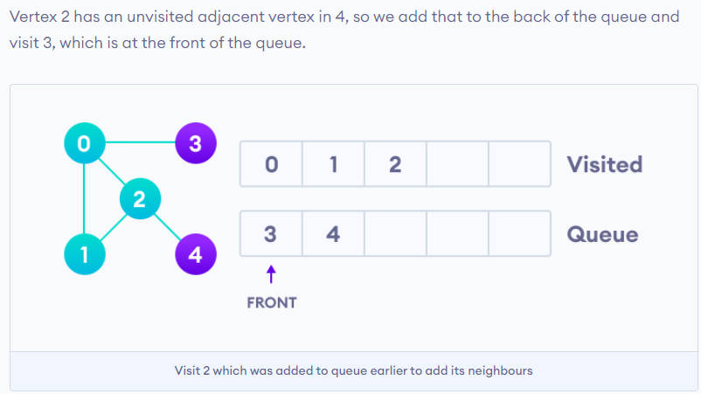
Graph Traversal : BFS

Slide 11
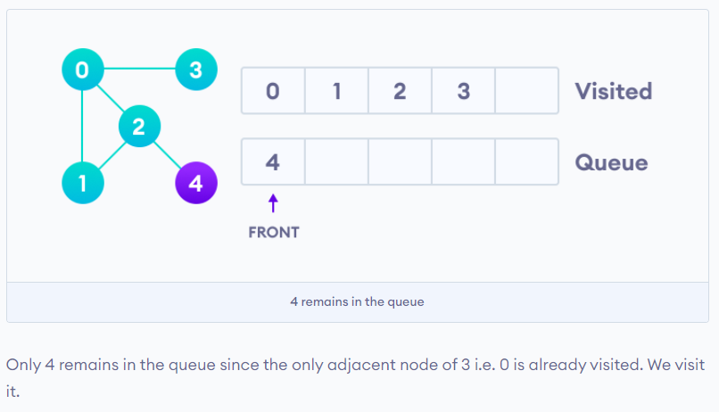
Graph Traversal : BFS

Slide 12
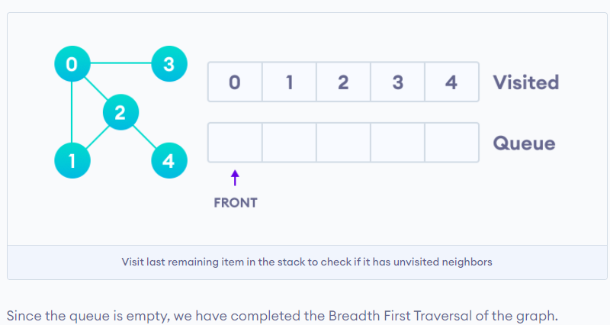
Graph Traversal : BFS

Slide 13
BFS, BF tree and shortest path
BFS(1)
BFS(s)
visit(s);
queue.insert(s);
while( queue is not empty ){
u = queue.extractHead();
for each edge <u, d>{
if(d has not been visited)
visit(d);
queue.insert(d);
}
}
1
2
3
4
5
6
1
4
2
5
Queue:
Visit order:
1
4
2
5

Slide 14
BFS, BF tree and shortest path
BFS(2)
BFS(s)
visit(s);
queue.insert(s);
while( queue is not empty ){
u = queue.extractHead();
for each edge <u, d>{
if(d has not been visited)
visit(d);
queue.insert(d);
}
}
1
2
3
4
5
6
2
5
4
Queue:
Visit order:
2
5
4

Slide 15
BFS, BF tree and shortest path
BFS(3)
BFS(s)
visit(s);
queue.insert(s);
while( queue is not empty ){
u = queue.extractHead();
for each edge <u, d>{
if(d has not been visited)
visit(d);
queue.insert(d);
}
}
1
2
3
4
5
6
3
6
5
4
2
Queue:
Note that: no matter visit 5 first or visit 6 first, they are BFS
Visit order:
3
6
5
4
2

Slide 16
BFS, BF tree and shortest path
Byproducts of BFS(s)
Breadth first tree
The tree constructed when a BFS is done
Shortest path
A path with minimum number of edges from one vertex to another
BFS(s) find out all the shortest paths from s to all its reachable vertices

Slide 17
BFS, BF tree and shortest path
1
2
3
4
5
6
1
1
4
2
5
BFS( ):
1
All shortest paths started from vertex 1 are found
e.g. 1 to 5
BF Tree:
4
2
5

Slide 18
BFS, BF tree and shortest path
1
2
3
4
5
6
2
2
5
4
BFS( ):
2
Shortest 2 to 5
BF Tree:
Shortest 2 to 4
5
4

Slide 19
BFS, BF tree and shortest path
1
2
3
4
5
6
3
3
6
5
4
2
BFS( ):
Shortest 3 to 6
3
BF Tree:
Shortest 3 to 5
5
6
Shortest 3 to 4
4
Shortest 3 to 2
2

Slide 20
BFS, BF tree and shortest path
BFS Traversal
BFS_Traversal(G)
for each v in G{
if (v has not been visited)
BFS(v);
}

Slide 21
BFS, BF tree and shortest path
BFS_Traversal(G)
for each v in G{
if (v has not been visited)
BFS(v);
}
1
2
3
4
5
6
1
4
2
5
3
6
Queue:
Visit order:
1
4
2
5
3
6

Slide 22
DFS, DF tree
Depth-first search
From a source vertex s
Depth-firstly search explores the edges to discover every vertex that is reachable from s
DFS(s):
s.underDFS = true; // grey
for each edge <s, d>{
if(! d.underDFS and d has not been visited)
DFS(d);
}
Visit(s); // black
From the deepest one to the current one

Slide 23
DFS, DF tree
DFS(1)
DFS(s):
s.underDFS = true;
for each edge <s, d>{
if((! d.underDFS and d has not been visited)
DFS(d);
}
Visit(s);
DFS(1)
DFS(2)
1
2
3
DFS(4)
4
5
6
DFS(5)
Visit order:
5
2
4
1

Slide 24
DFS, DF tree
DFS(2)
DFS(s):
s.underDFS = true;
for each edge <s, d>{
if((! d.underDFS and d has not been visited)
DFS(d);
}
Visit(s);
DFS(2)
1
2
3
4
5
6
DFS(4)
DFS(5)
Visit order:
4
5
2

Slide 25
DFS, DF tree
DFS(3)
DFS(s):
s.underDFS = true;
for each edge <s, d>{
if((!d.underDFS and d has not been visited)
DFS(d);
}
Visit(s);
DFS(2)
DFS(3)
1
2
3
DFS(6)
4
5
6
DFS(4)
DFS(5)
Visit order:
6
2
4
5
3
The reachable vertices are exactly the same with BFS, but with a different order

Slide 26
DFS, DF tree
Depth first tree
The tree constructed when a DFS is done

Slide 27
DFS, DF tree
DF Tree of DFS(1)
1
2
3
1
2
4
5
6
4
5
DF Tree
Visit order:
5
2
4
1

Slide 28
DFS, DF tree
DF Tree of DFS(2)
1
2
3
2
4
5
6
4
5
DF Tree
Visit order:
4
5
2

Slide 29
DFS, DF tree
DF Tree of DFS(3)
1
2
3
2
3
4
5
6
4
5
6
DF Tree
5
6
2
2
4
4
5
Visit order:
1
3

Slide 30
DFS, DF tree
DFS Traversal // (The DFS in the textbook)
DFS_Traversal(G)
for each v in G{
if (v has not been visited)
DFS(v);
}

Slide 31
DFS, DF tree
DFS_Traversal(G)
DFS_Traversal(G)
for each v in G{
if (v has not been visited)
DFS(v);
}
DFS(1)
DFS(2)
DFS(3)
1
2
3
DFS(4)
DFS(6)
4
5
6
DFS(5)
Visit order:
5
2
4
1
6
3

Slide 32
TOPOLOGICAL SORT
An application of DFS that deals with “dependency” constraints

Slide 33
ASIDE: DIRECTED ACYCLIC GRAPHS
A Directed Acyclic Graph (DAG) is a directed graph with no directed cycles.
These are DAGs:
These are not DAGs:

Slide 34
Topological sort
DAG: directed acyclic graph
A graph without cycles
1
2
3
4
5
6
Dag?
No

Slide 35
Topological sort
DAG: directed acyclic graph
A graph without cycles
1
2
3
4
5
6
Dag?
No

Slide 36
Topological sort
Ordering in DAGs
If there is an edge <u, v>, then u appears before v in the ordering
1
2
3
4
5
6
Dag?
Yes

Slide 37
Topological sort
Example
1
2
3
4
5
6
3
5
6
1
4
2
Put all the topological sorted vertices in a line, all edges go from left to right

Slide 38
Topological sort
How to topological sort a dag?
Just use DFS_Traversal
The reverse order of DFS_Traversal is a topological sorted order

Slide 39
Topological sort
1
2
3
4
5
6
2
4
1
6
5
3
DFS_Traversal(G):
3
5
6
1
4
2

Slide 40
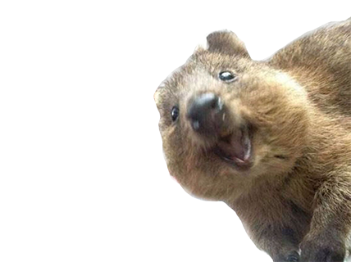
DFS WILL GET US A Topological Sort
TOPOSORT: Perform DFS. When a vertex gets its finish time, insert it at the start of the list.
start: 13
finish: 14
CS 109
CS 161
start: 7
finish: 10
CS 103
start: 8
finish: 9
start: 4
finish: 5
CS 166
CS 106B
CS 107
start: 1
finish: 12
CS 106A
start: 2
finish: 11
start: 3
finish: 6
This is a valid toposort ordering!
CS 109
CS 106A
CS 106B
CS 103
CS 161
CS 107
CS 166
f: 14
f: 12
f: 11
f: 10
f: 9
f: 6
f: 5

